Slide 1
LAD/LAPE in LIT MARKET ENDO vs. EXOG
 |  | LAD (lit) |  |  | LAPE (lit)
 |  | Lit only | Lit & Dark | p value | Lit only | Lit & Dark | p value
Low precision (64) | endo | 3.052 | 3.417 | 0.0487 | 4.271 | 4.389 | 0.3167
 |  | (1.572) | (1.579) |  | (1.780) | (1.416)
 | exog | 3.098 | 3.573 | 0.0624 | 4.213 | 4.264 | 0.8146
 |  | (2.171) | (1.155) |  | (2.190) | (1.323)
High precision (73) | endo | 2.131 | 2.300 | 0.1593 | 2.218 | 2.444 | 0.1211
 |  | (2.127) | (1.828) |  | (2.223) | (1.940)
 | exog | 2.374 | 2.554 | 0.4696 | 2.428 | 2.803 | 0.2982
 |  | (1.932) | (1.726) |  | (1.940) | (1.845)
In the low precision treatment, LAD in the lit market is significantly higher when a dark market is added.

Slide 2
LAD in Lit Market
 |  | 1st half (Period 1-10) |  |  | 2nd half (Period 11-20)
 |  | Lit only | Lit & Dark | p value | Lit only | Lit & Dark | p value
Low precision (64) | endo | 3.11 | 3.54 | 0.0947 | 2.99 | 3.30 | 0.2417
 |  | (1.44) | (1.53) |  | (1.70) | (1.63)
 | exog | 3.01 | 3.36 | 0.1653 | 3.18 | 3.79 | 0.2648
 |  | (1.98) | (1.15) |  | (2.40) | (1.15)
High precision (73) | endo | 2.58 | 2.96 | 0.3067 | 1.67 | 1.64 | 0.1210
 |  | (1.85) | (1.90) |  | (2.30) | (1.50)
 | exog | 2.66 | 2.65 | 0.9680 | 2.09 | 2.46 | 0.3408
 |  | (1.78) | (1.65) |  | (2.08) | (1.83)
Dark market access worsens price accuracy in the lit market when information precision is low, especially in the early periods and when information acquisition is endogenous. However, this effect becomes weaker over time and is not robust across all treatments. When information precision is high, the differences between Lit only and Lit & Dark markets are small and statistically insignificant.

Slide 3
Table VI OLS Regression of LAD in the Lit Market (ENDO VS. EXOG)
 | Endo |  |  |  |  |  | Exog
 | Low precision |  |  | High precision |  |  | Low precision |  |  | High precision
 | (1) | (2) | (3) | (4) | (5) | (6) | (7) | (8) | (9) | (10) | (11) | (12)
Dark | 0.365 | -0.0172 | -0.0216 | 0.178 | -0.749** | -0.580** | 0.682** | 0.559** | 0.832*** | 0.464 | -0.387 | 0.143
 | (0.278) | (0.353) | (0.297) | (0.426) | (0.260) | (0.249) | (0.205) | (0.185) | (0.234) | (0.642) | (0.555) | (0.670)
Sum of signals acquired |  |  | 0.0406** |  |  | -0.0539*** |  |  | -0.0244* |  |  | -0.0457
 |  |  | (0.0133) |  |  | (0.0137) |  |  | (0.0124) |  |  | (0.0319)
Age |  | 0.489 | 0.647** |  | 0.895*** | 0.891*** |  | -0.336 | -0.709* |  | -0.249 | -0.330
 |  | (0.279) | (0.248) |  | (0.174) | (0.176) |  | (0.236) | (0.318) |  | (0.340) | (0.355)
Gender |  | -0.209 | 1.799 |  | 2.225 | -0.645 |  | -5.555* | -9.733** |  | 9.349*** | 8.408***
 |  | (0.730) | (1.041) |  | (2.388) | (2.661) |  | (2.880) | (3.504) |  | (1.848) | (1.772)
Major in Econ |  | -0.890 | 0.988 |  | -2.498** | -3.892*** |  | 2.853 | 5.955* |  | -10.22*** | -8.980***
 |  | (0.566) | (1.021) |  | (1.061) | (1.129) |  | (2.014) | (2.566) |  | (1.877) | (1.644)
Risk Aversion |  | 0.130 | -0.412* |  | -0.882*** | -0.970*** |  | -0.0205 | -0.135 |  | -1.769*** | -1.641***
 |  | (0.147) | (0.207) |  | (0.249) | (0.221) |  | (0.131) | (0.131) |  | (0.447) | (0.380)
Period | -0.0140 | -0.0140 | -0.0266 | -0.117*** | -0.117*** | -0.137*** | 0.0105 | 0.0105 | 0.0144 | -0.0798** | -0.0798** | -0.0895**
 | (0.0132) | (0.0133) | (0.0164) | (0.0299) | (0.0302) | (0.0272) | (0.0138) | (0.0140) | (0.0141) | (0.0253) | (0.0256) | (0.0312)
Constant | 3.199*** | -7.889 | -10.71* | 3.354*** | -10.79** | -6.465 | 2.698*** | 11.96 | 22.56** | 2.841*** | 20.55* | 22.75**
 | (0.299) | (6.066) | (5.515) | (0.439) | (3.790) | (4.522) | (0.268) | (6.492) | (8.690) | (0.550) | (8.708) | (9.316)
Observations | 240 | 240 | 240 | 238 | 238 | 238 | 160 | 160 | 160 | 160 | 160 | 160
Clusters | 12 | 12 | 12 | 12 | 12 | 12 | 8 | 8 | 8 | 8 | 8 | 8
R-squared | 0.016 | 0.037 | 0.072 | 0.119 | 0.209 | 0.235 | 0.044 | 0.057 | 0.066 | 0.081 | 0.209 | 0.223

Slide 4
Table VI OLS Regression of LAD in the Lit Market (exog)
 | Low precision |  | High precision
 | (1) | (2) | (3) | (4)
Dark | 0.704** | 0.581* | 0.586 | -0.264
 | (0.297) | (0.269) | (0.725) | (0.543)
2nd half | 0.218** | 0.218** | -0.559** | -0.559**
 | (0.0890) | (0.0902) | (0.213) | (0.216)
Dark × 2nd half | -0.0436 | -0.0436 | -0.245 | -0.245
 | (0.295) | (0.299) | (0.438) | (0.444)
Age |  | -0.336 |  | -0.249
 |  | (0.237) |  | (0.341)
Gender |  | -5.555* |  | 9.349***
 |  | (2.889) |  | (1.854)
Major in Econ |  | 2.853 |  | -10.22***
 |  | (2.021) |  | (1.884)
Risk Aversion |  | -0.0205 |  | -1.769***
 |  | (0.132) |  | (0.449)
Constant | 2.700*** | 11.96 | 2.283*** | 19.99*
 | (0.216) | (6.499) | (0.595) | (8.740)
Observations | 160 | 160 | 160 | 160
Clusters | 8 | 8 | 8 | 8
R-squared | 0.046 | 0.059 | 0.053 | 0.181

Slide 5
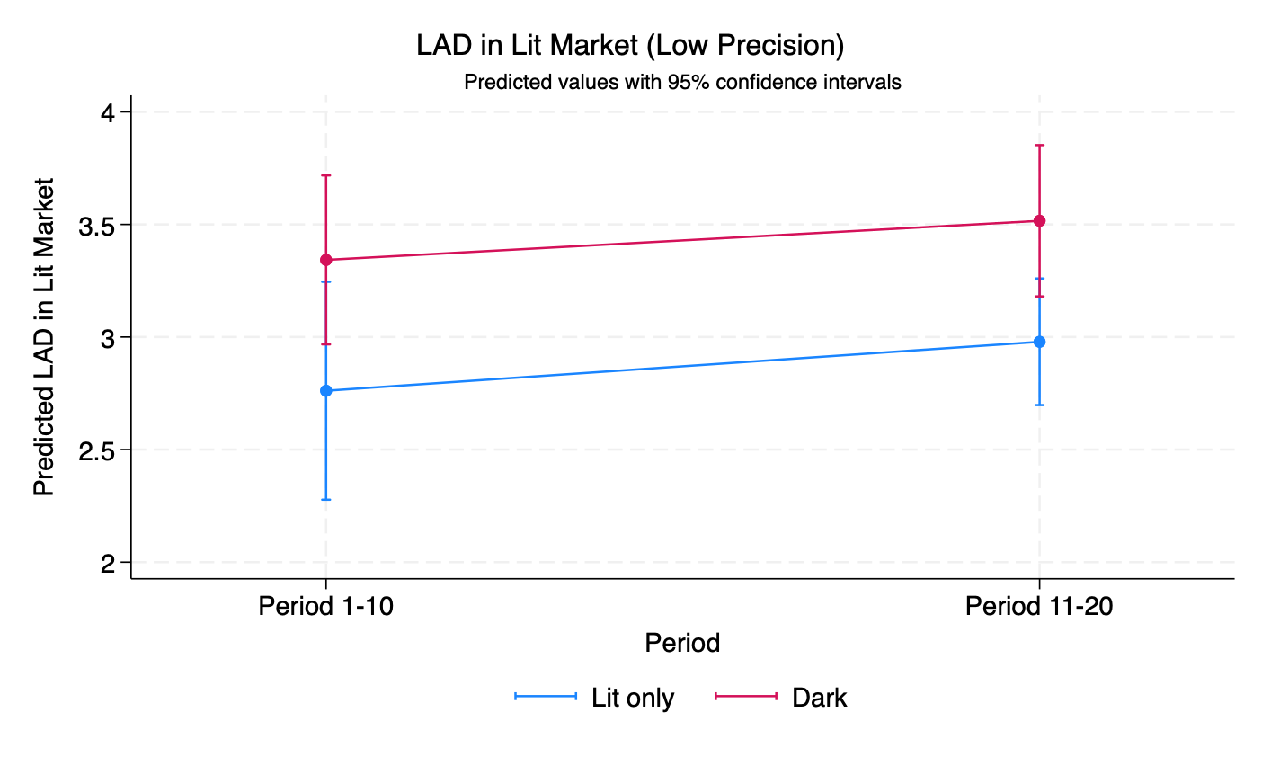
exog

Slide 6
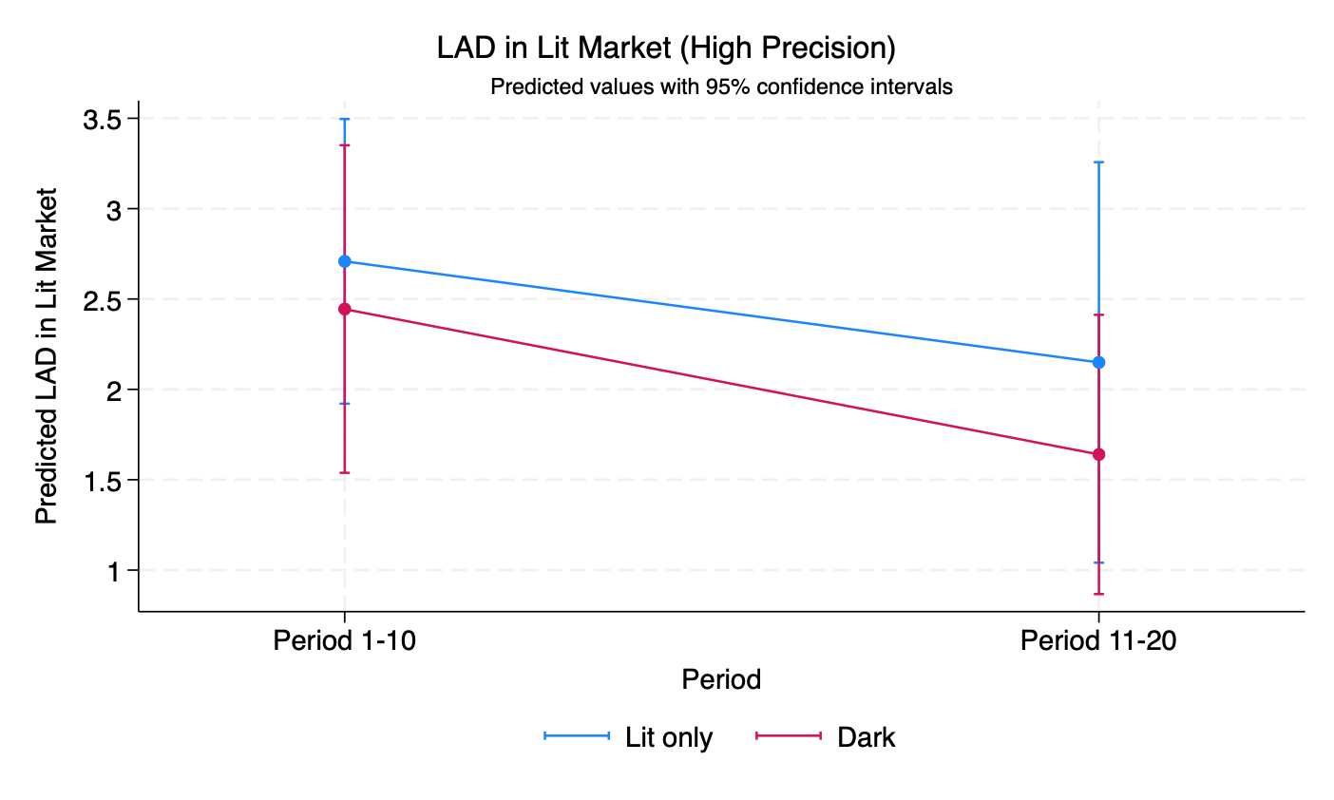
exog

Slide 7
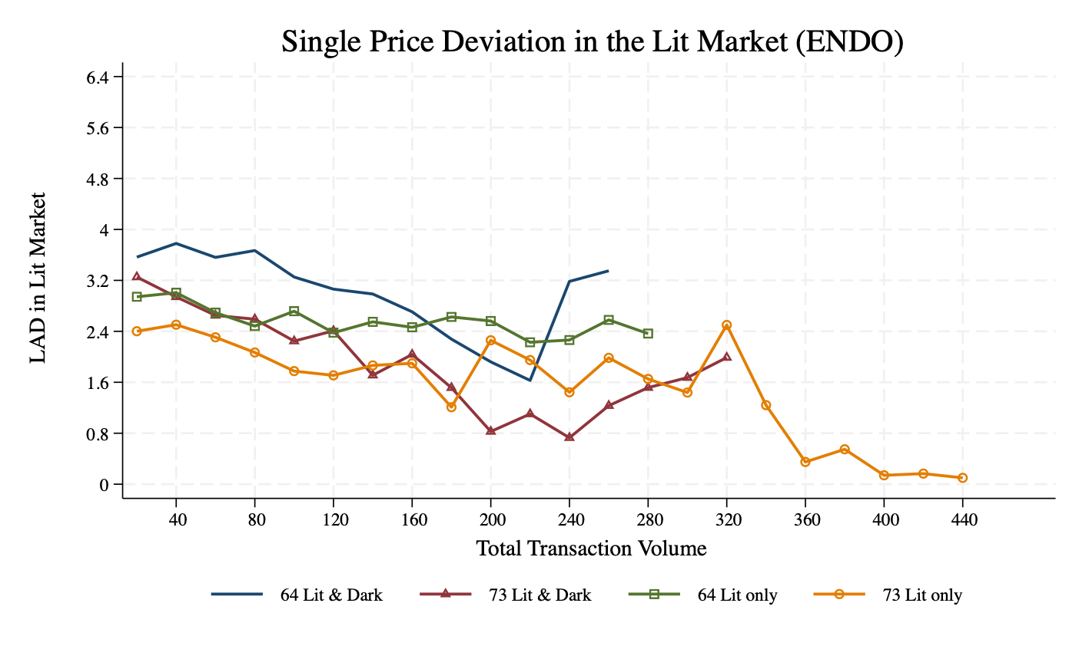

Slide 8
